Slide 1
Positive Environments

Slide 2
Positive Environments
Positive Schooling
Good Work
Balance between Me and We

Slide 3
Positive Schooling
Positive schooling includes positive education.
Unlike traditional school approaches in which teachers attempt to tailor their material to a mythical "average" student, and move the class altogether using the material through one teaching and testing style, positive schooling teachers use techniques that focus on the well-being of individual students.
Positive Schooling
“An approach to education that consists of a foundation of care, trust, and respect for diversity, where teachers develop tailored goals for each student to engender learning and then work with him or her to develop the plans and motivation to reach their goals.” it emphasis of individual strengths and personal motivation to promote learning
Components of Positive Schooling

Slide 4
Components of Positive Schooling
Goals
provide a means of targeting learning efforts
agreed upon by teacher & student
stretch goals
understandable and concrete
Plans and Motivation
careful planning of activities
make material relevant to personal lives
sensitive to student needs & reactions
take risks;
try new approaches
use humor
Hope
- students believe that she or he will continue to learn long after class ends
Societal Contributions
- students see selves as part of larger society; share learning
Teachers who
Care
- consistently responsive/available
Are trustworthy
Respect for Diversity
- highlight commonalities; normalize differences
avoid cynicism about students
- listen to students
- attend to cultural context
- spend time with students
- encourage inclusivity
GPS Ho T

Slide 5
Teaching as a Calling
Calling:
a strong motivation in which a person repeatedly takes a course of action that is intrinsically satisfying
Teaching as a privilege: a chance to make a positive difference
Giving Back to Teachers
What you can do to make teachers better:
- work with teachers toward improvement
- work with kids outside of school
- teach children respect of other views
- volunteer at school
- show gratitude

Slide 6
Behavioral Errors: In Absence of Positive Education
Students do not have appropriate skills (i.e., skill deficits)
Students do not know when to use skills
Students are not taught what they need to know
Skills are not taught in context

Slide 7
My School’s
Expectations…
1. Be Safe
2. Be Responsible
3. Be Respectful
Once you have developed school-wide expectations, it is not enough to just post the words on the walls of the classroom…
YOU MUST TEACH THEM!
Notes:
Can’t just put them on the wall and walk away..
If you emphasize it the kids will…
If you model it the kids will…
Consistently recognize students who are doing it.

Slide 8
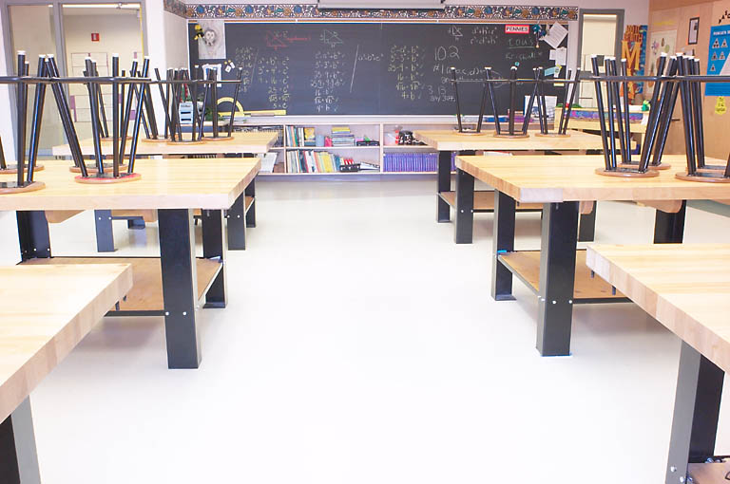
Transforming School Culture

Slide 9
School Culture is over a period of time…the history
Climate is now, it’s the perceptions/ emotions being evoked
Why Is School Culture Important?
What research tells us:
“Positive learning can only take place in a positive culture. A healthy school culture will affect more student and teacher success than any other reform or school improvement effort currently being employed.”
-Gary Phillips
School Culture
School culture is norms developed over time based on shared attitudes, values, beliefs, expectations, relationships, and traditions of a particular school that cause it to function or react as it does.

Slide 10
School Climate
School climate is the communication of its norms, beliefs, and values through various behaviors ,with the primary focus being on students.
School Climate is driven by and reflected in the daily interactions of staff, administration, students, support staff, and the outside community.

Slide 11
ACCIDENTAL vs INTENTIONAL
CULTURE
Accidental Culture | Intentional Culture
1. Activities are based on assumptions. | 1. Activities are research-based.
2. Academic goals deteriorate to a wish list. | 2. Academic goals are credible. The focus is on results.
3. Mission and goals are ignored. | 3. Mission and goals are used as a blue print for school improvement.
4. Decisions are dictated and developed by few. | 4. Broad collaboration: decisions are widely shared

Slide 12
ACCIDENTAL vs INTENTIONAL
CULTURE
Accidental Culture | Intentional Culture
5. Articulated Beliefs | 5. Beliefs are tied to actions and behaviors.
6. Random Values | 6. Values tied to vision and mission
7. Connections are random | 7. Connections are constantly sought
8. Diversity is acknowledged | 8. Diversity is valued

Slide 13
Positive School Culture/Climate
Stories that celebrate successes and recognize them
isme example likh dena
Physical Environment reflects pride and joy
Widespread sense of respect and nurturing

Slide 14
A MOMENT OF CLARITY
I learned that …
I realized that …
I was pleased that …
I was not aware that…

Slide 15
Gainful Employment
Nine benefits:
Variety in duties
Safe environment
Income
Sense of purpose
Happiness/satisfaction
Engagement
Performing well/meeting goals
Companionship with colleagues
Environment respectful of diversity

Slide 16
Gainful Employment:
Happiness & Satisfaction
Much research on job satisfaction
Happiness at work related to overall life satisfaction (r = .40)
Employed people = high reported happiness vs. unemployed
Providing a Product or Service
Want to feel that one is contributing to others or society
Contributions could be large or in relatively small ways
Performing Well & Meeting Goals
Career self-efficacy
the personal confidence in one’s capacity to handle career development and work-related goal activities.
Related to career success & satisfaction
Goals at work:
clear goals linked to performance
Bidirectional nature of performance and happiness
Happiness may be precursor to career success

Slide 17
Gainful Employment:
Engagement & Involvement
Engagement:
involvement with one’s work
occurs when needs are met
know what is expected
have what is needed
match between skills & requirements
resembles flow (flow more likely at work than leisure!)
commitment
Income for Family & Self
Minimum income needed
Money overrated as a happiness source
Positive Parenting Program
- work/family balance

Slide 18
Gainful Employment:
Companionship & Loyalty to Coworkers & Bosses
2006 Vital Friends Assessment:
- sense of community at work = happiness & satisfaction
- many benefits of a “best friend” at work
Safe Work Environments
Physical work environment:
care for welfare of workers
- physically safe
- injury free
Respect & Appreciation for Diversity in the Workplace
Diversity management:
- “using various management techniques that increase the positive outcomes associated with having more diversity in the workplace”

Slide 19
Having or Being a Good Boss
To increase employee satisfaction and productivity supervisors should:
provide clear job definitions/duties
support employees
be genuine & authentic
behave ethically
be honest/model integrity
focus on talents & strengths
trust employees
encourage diversity
set high but reasonable standards
have personal awareness & strive for cultural competency

Slide 20
Strengths-Based Approach to Work
Three Stages of Clifton strengths –-based approach to gainful employment:
1. Identification of talents
2. Integration of talents into self- image
3. Attribute successes to talents

Slide 21
Capital at Work
Fred Luthans, University of Nebraska
-view of capital that emphasizes the individual worker
- grew out of traditional view of economic capital

Slide 22
Capital at Work

Slide 23
The Dark Side:
Workaholics
People who become obsessed by their work – so much so that they cannot attend to the responsibilities of their friends and family.
Staying late on the job
Working harder than others
Seeking perfectionism
Conflict between work & family
Type A behavior
Burnout
A cyclical process:
- high level of energy begins to wane over time
- several time constraints
- barriers to work goals
- no rewards but asked to do more due to productivity
- employee becomes exhausted
Paradox:
- effective, hard-worker asked to do more
- those with the most enthusiasm most vulnerable

Slide 24
The Dark Side:
Job Loss
Unemployment linked to early death
Increases suicide risk
Links to alcohol-related diseases & cancers
Triggers a carousel of negative events
Ways to Improve Your Work
Making your job better
Applying for a new job
Applying For a New Job
Remaining flexible is key
Take a vocational/interest test
Conduct informational interviews with people who are doing well in such careers
learn about the organization before the interview

Slide 25
Building Positive and Good Relationships at Work

Slide 26
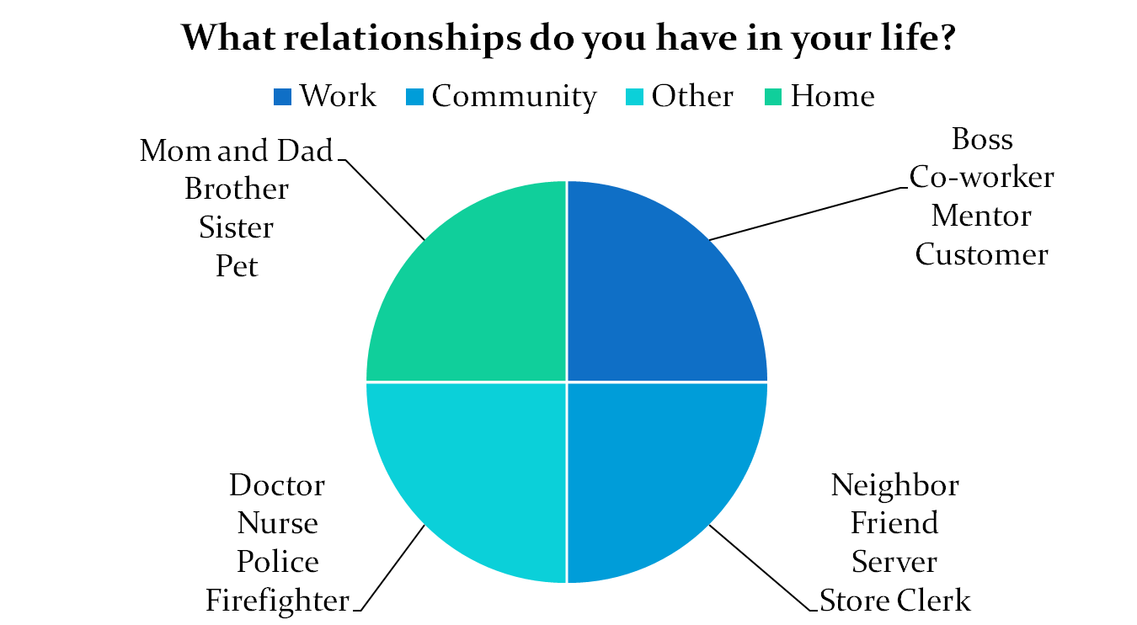
Relationships in our Lives

Slide 27
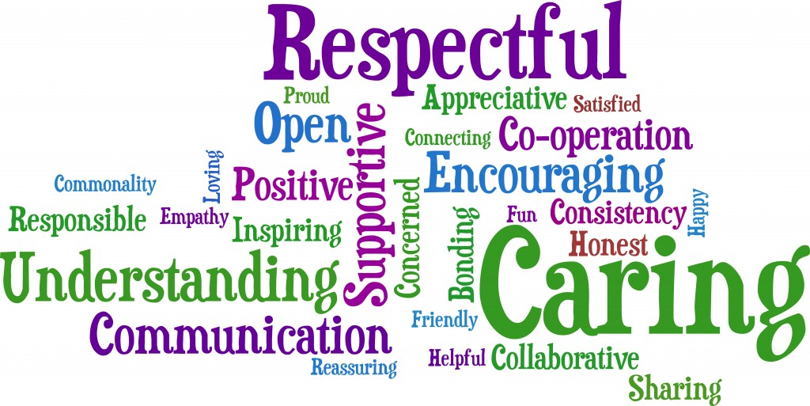
How do you create positive relationships with others at work?

Slide 28

Be respectful
How do you show respect to others at work?
How do they show respect to you?
I treat others as I want them to treat me.

Slide 29
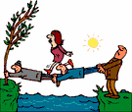
Cooperate with others
How does this image show cooperation?
Can one person cross the water without help from the others?
How do you cooperate with others at work?

Slide 30
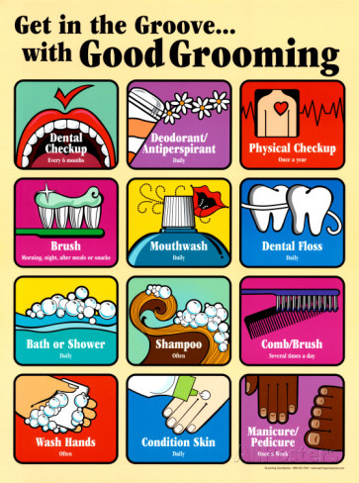
Be neat and clean
How do you feel when you are working near someone who is not clean and smells badly?
How do you keep your body clean for work?
How do you keep your clothes clean for work?
On a scale of 1 to 10 how do you rate your cleanliness and appearance?
If you need to improve your cleanliness and appearance, how will you?

Slide 31
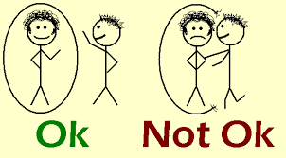
Honor personal space
What difference do you see between these two personal interactions?
How close is too close for you? And for others?
You can get into a lot of trouble if you hug, kiss or touch a co-worker.
It’s up to you to understand that a co-worker might get upset with your
actions even if you think you are not doing anything wrong. If a co-worker
becomes upset with you for trying to hug, kiss, touch or invade his or her
personal space, it can be called HARRASSMENT.

Slide 32

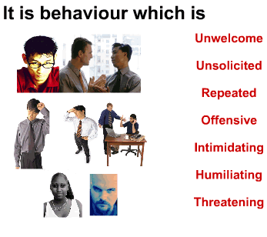
Harassment is against the law
Harassment is not only about touching or invading someone’s personal space at work. It is also about what is said or other unwelcome actions. Offensive conduct may include, but is not limited to offensive jokes, slurs, epithets or name calling, intimidation, ridicule or mockery, insults or put-downs, offensive objects or pictures, and interference with work performance.
What words or actions can you think of that might be harassment?
What should you do to make sure you are not harassing a co-worker?
What should you do if you feel that someone is harassing you at work?

Slide 33

Doing a good job is always #1
How do you make sure you are doing the very best job you can?
How does it make you feel when you are doing your very best?

Slide 34
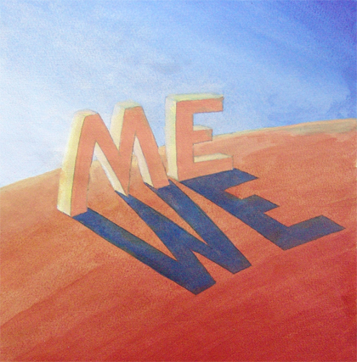
Balance between ME and WE

Slide 35
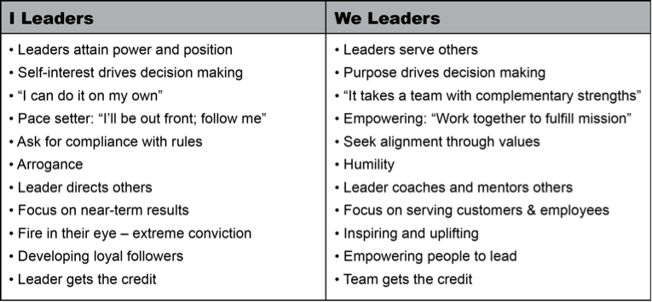
‘I’ & ‘WE’ LEADERS

Slide 36
How to maintain balance between Me and We
Be happy about what you have
Show your gratitude to others
Be positive and active
Try to understand others’ perspectives
Give respect to others
Be knowledgeable and rationalistic
Inclined your emotions on ‘WE’ side rather on ‘I’ side.

